Slide 1
presented by Amanda, Charity, & Sergio
Project 4

Slide 2
Agenda
Introduction
Key Takeaways
Data Collection Methods
Cleaning Process

Slide 3
Data
For this project, a database was pulled from UC Irvine Machine Learning Repository.
Project Description
The primary objective is to utilize machine learning models on a dataset of patient information to predict whether a person has heart disease.

Slide 4

Extraction/Data Collection

Slide 5
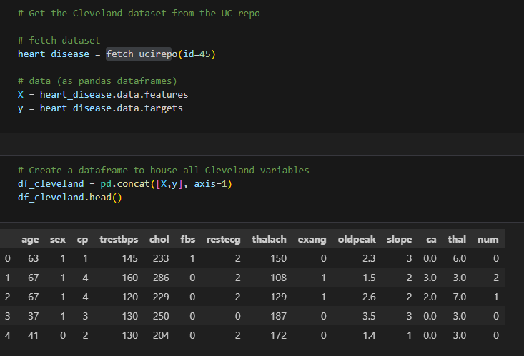
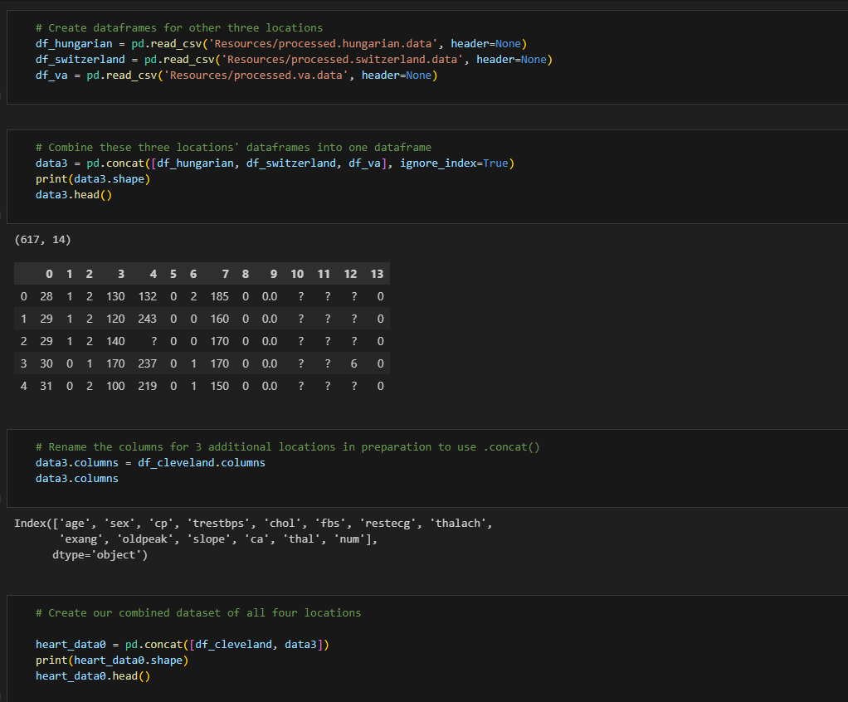
Fetching data from UC repo
We Began by grabbing our first dataset from the provided Repo.
Only Data from Cleveland was provided in the repo
2.) Fetching remaining data sets
The data from the other three locations-- Hungary, Switzerland, and VA Long Beach-- which we downloaded as .data files from the UC repo.
Finally, we will combine the four locations into one dataset.

Slide 6
Transform/Data Cleaning

Slide 7
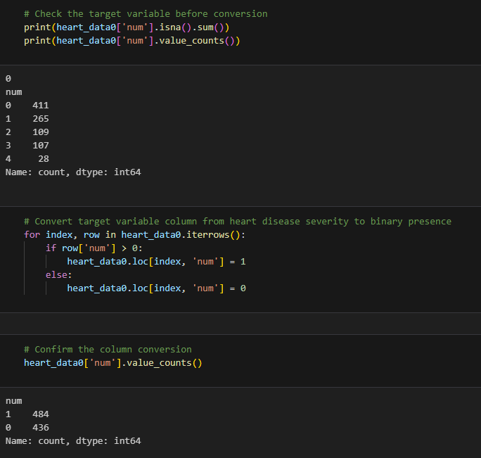
Transforming Data
The dataset contains a categorical variables. ‘num’, which indicates the presence and severity of heart disease on a scale of 0 to 4.
For the purpose of our analysis, we will convert this into a binary variable that indicates the presence of heart disease.

Slide 8
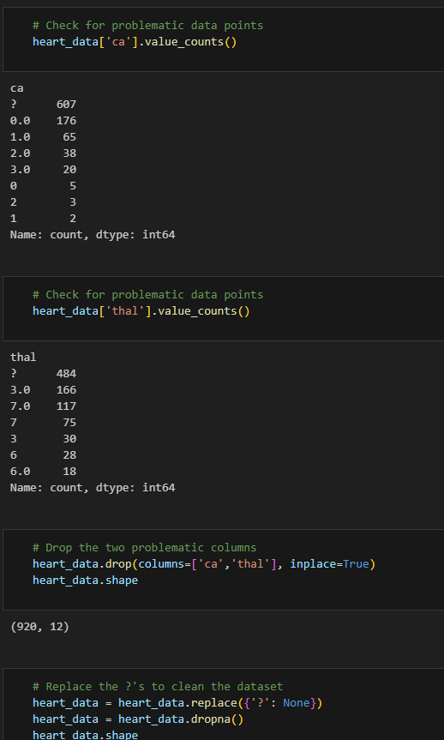
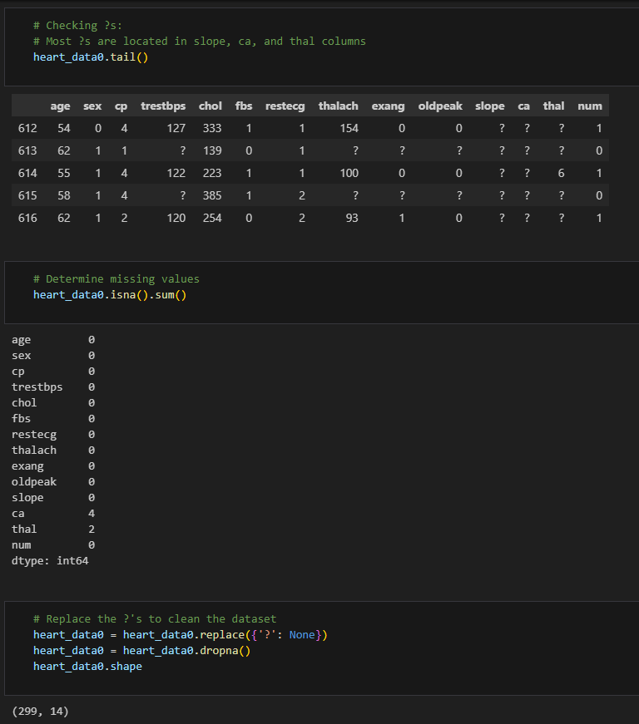
Transforming Data
Many cells contain a “?” As an entry, which is not detected as a missing value, so we will convert cells with ?’s to Na’s then use .dropna()
Our number of observations falls to just 299, which is hardly better than just using the Cleveland dataset is isolation. Instead, we will drop the two most problematic columns, ‘ca’ and ‘thal’, before using the .replace() function, to keep more observation instact.

Slide 9
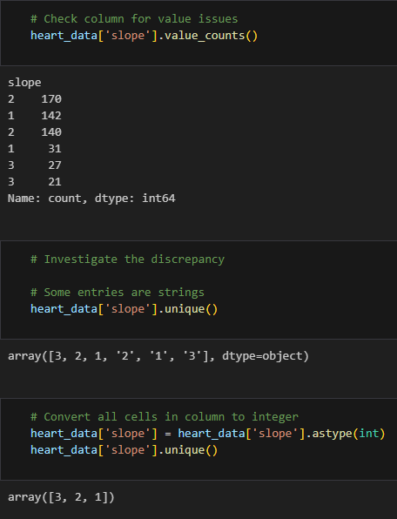
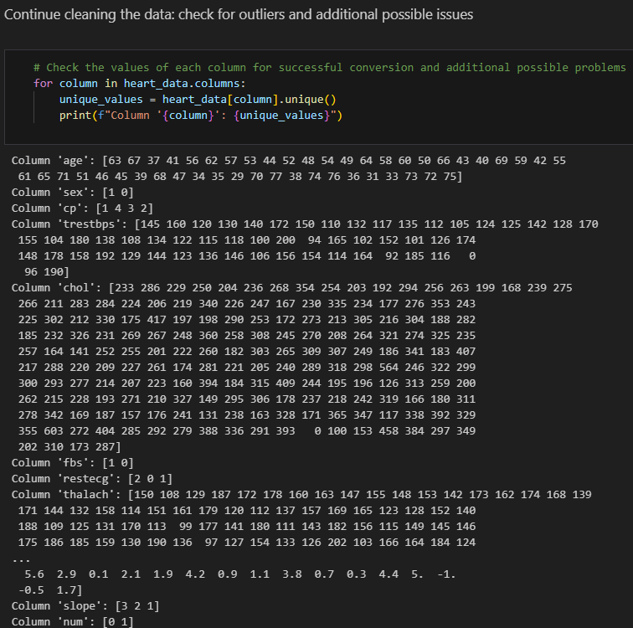
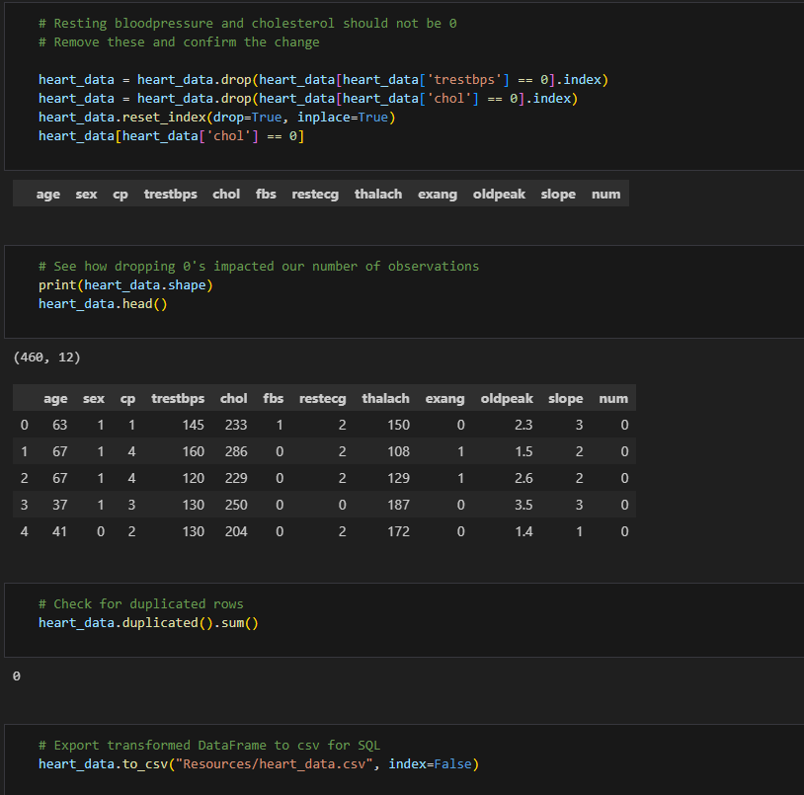
Cleaning Data
Finished cleaning the data by removing cells with identical values that were being read as two separate numbers
checked for outliers and additional possible issues

